Slide 1
CSE-2211: Database Management System Lab
Group: B-4
Ibna Afra Roza (16)
Mehedi Hasan (22)

Slide 2

Overview
Goriber Gari is a full-stack e-commerce platform designed for a seamless car purchasing experience. It allows users to browse a wide catalog of vehicles, view detailed information, and make purchases directly through the website.
GitHub: CSE-2211-Project
YouTube: Demo Video

Slide 3
Tech Stacks
Frontend: React JS, Axios, Bootstrap
Backend: FastAPI, SQLAlchemy
Database: PostgreSQL

Slide 4
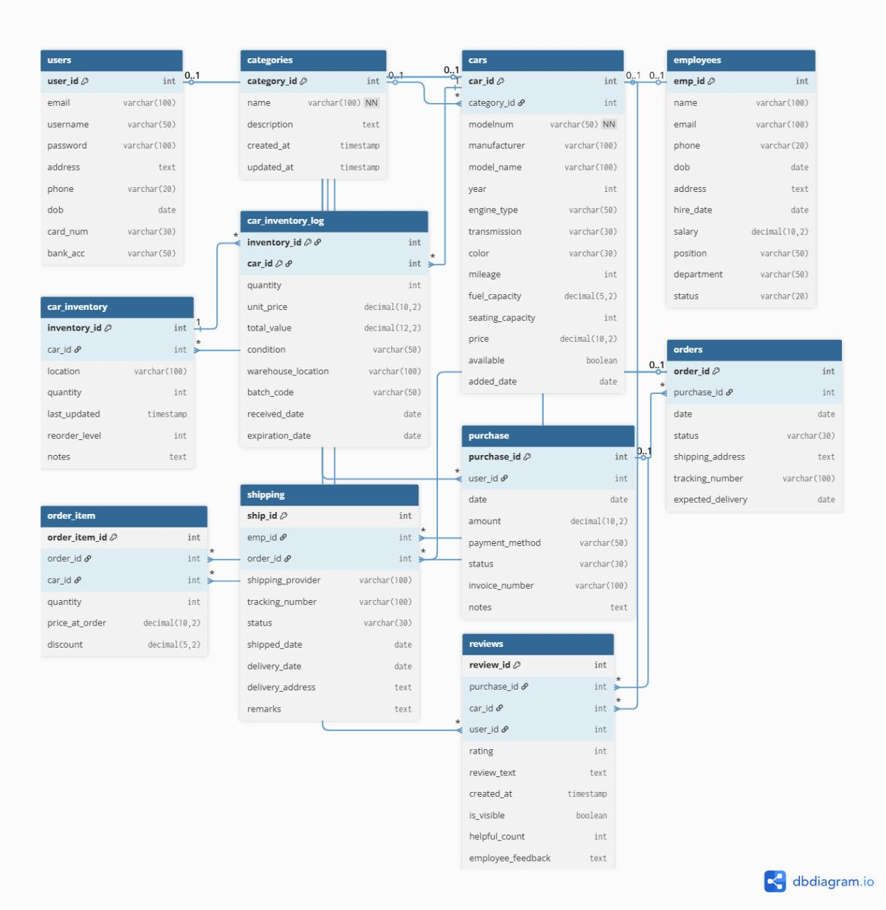
Schema Diagram

Slide 5
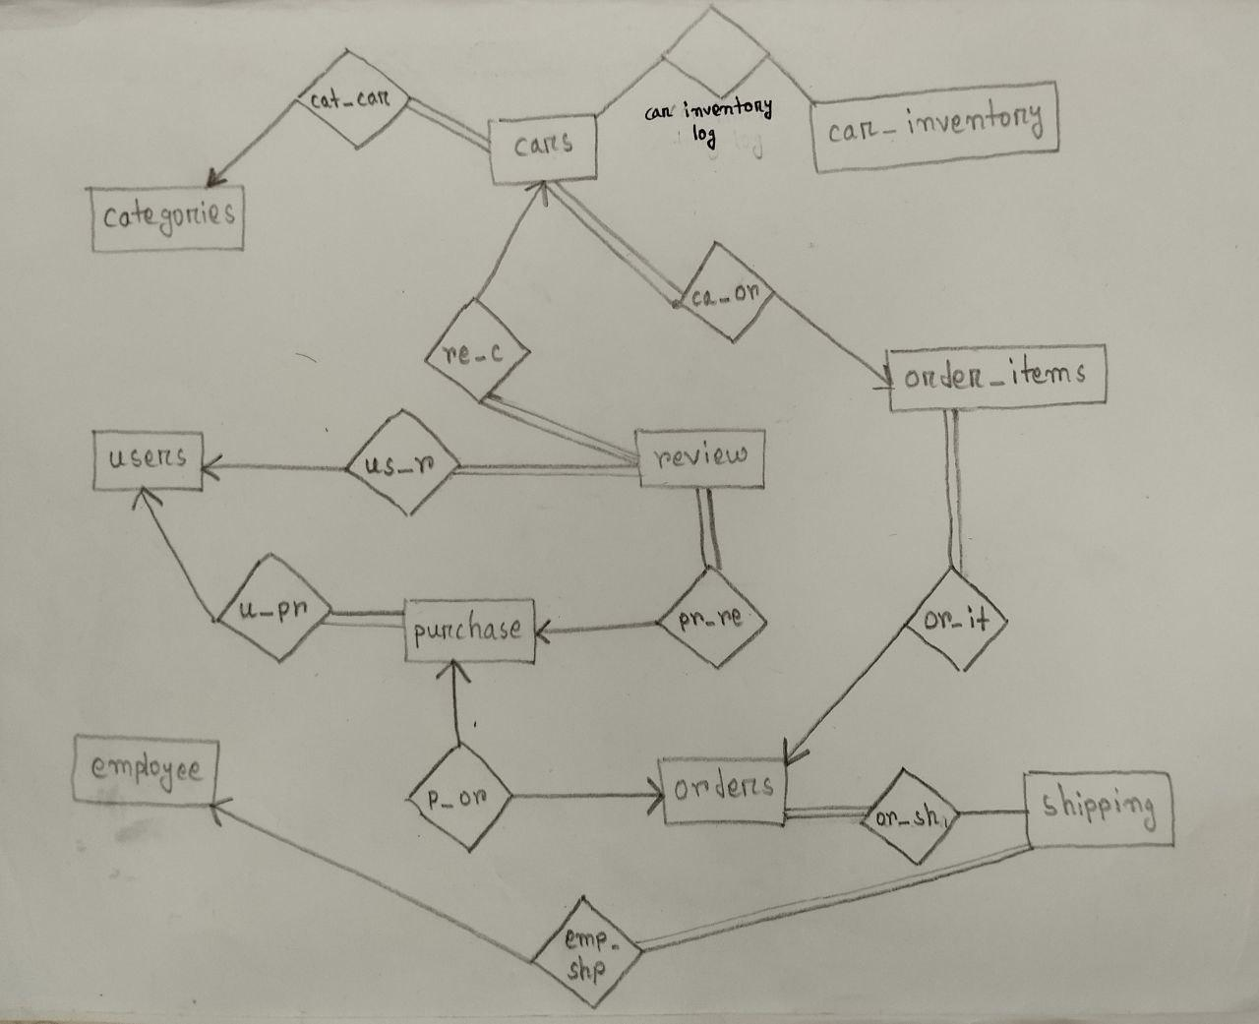
ER Diagram

Slide 6
Normal Form
 | 1NF | 2NF | 3NF | BCNF
users | yes | yes | yes | yes
cars | yes | yes | no | no
car_inventory | yes | yes | yes | yes
category | yes | yes | yes | yes
car_inventory_log | yes | yes | yes | yes
reviews | yes | yes | no | no

Slide 7
Normal Form
 | 1NF | 2NF | 3NF | BCNF
employees | yes | yes | yes | no
orders | yes | yes | no | no
order_items | yes | yes | yes | yes
purchase | yes | yes | yes | yes
shipping | yes | yes | no | no

Slide 8
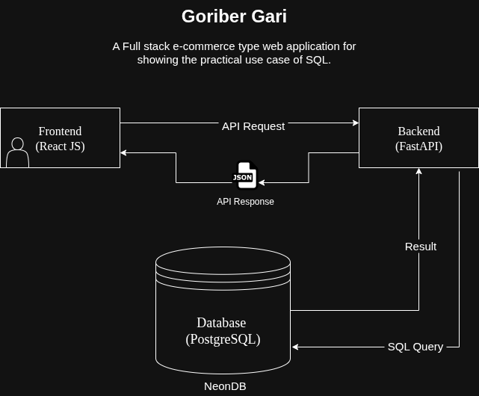
System Architecture

Slide 9
Features
User Authentication
Product Catalog
Detailed Car View
Shopping Cart
Checkout Process
User Profiles
Inventory Management
Money Receipt

Slide 10
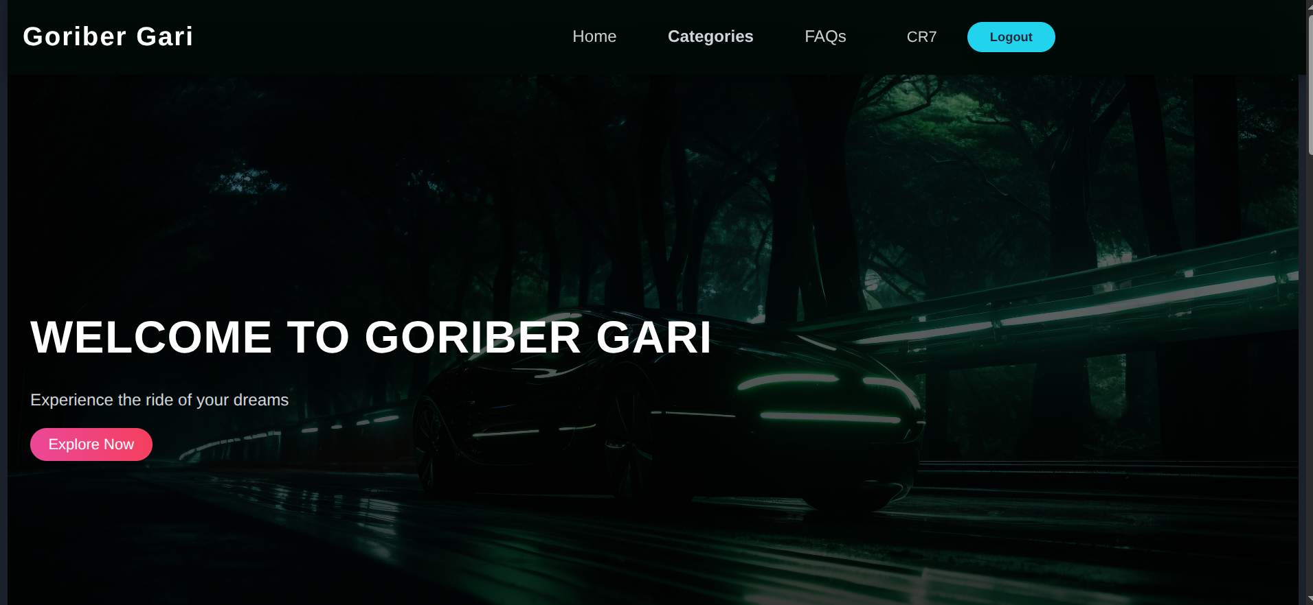
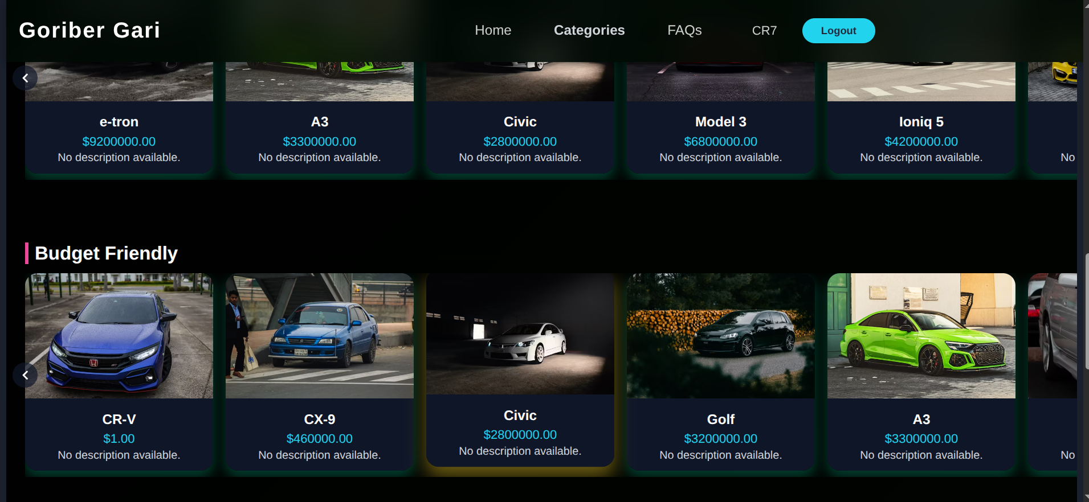
UI
Welcome Page
Welcome Page

Slide 11
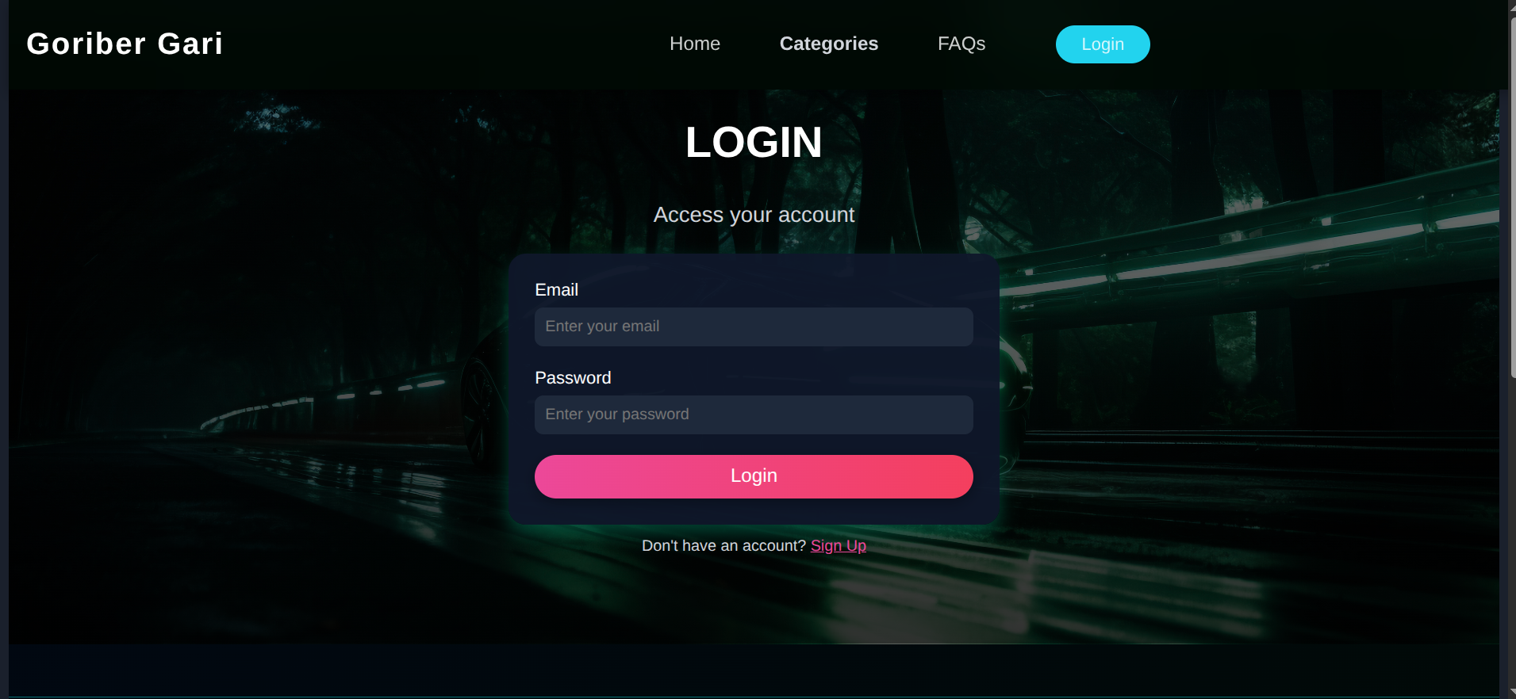
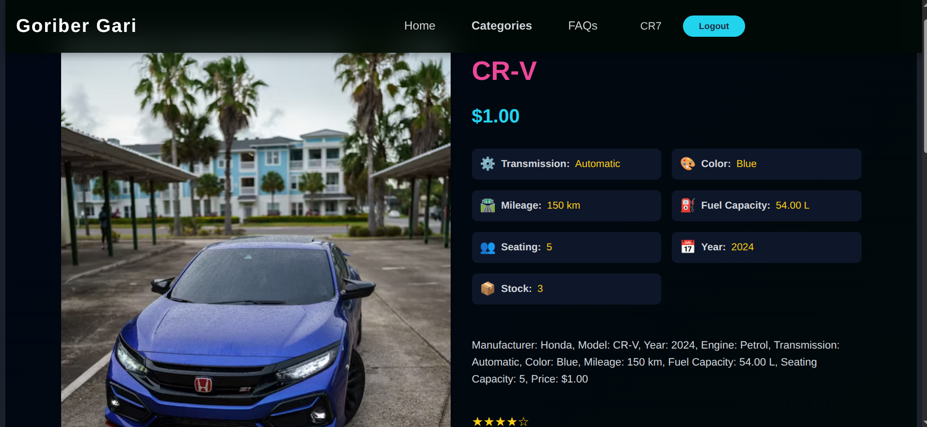
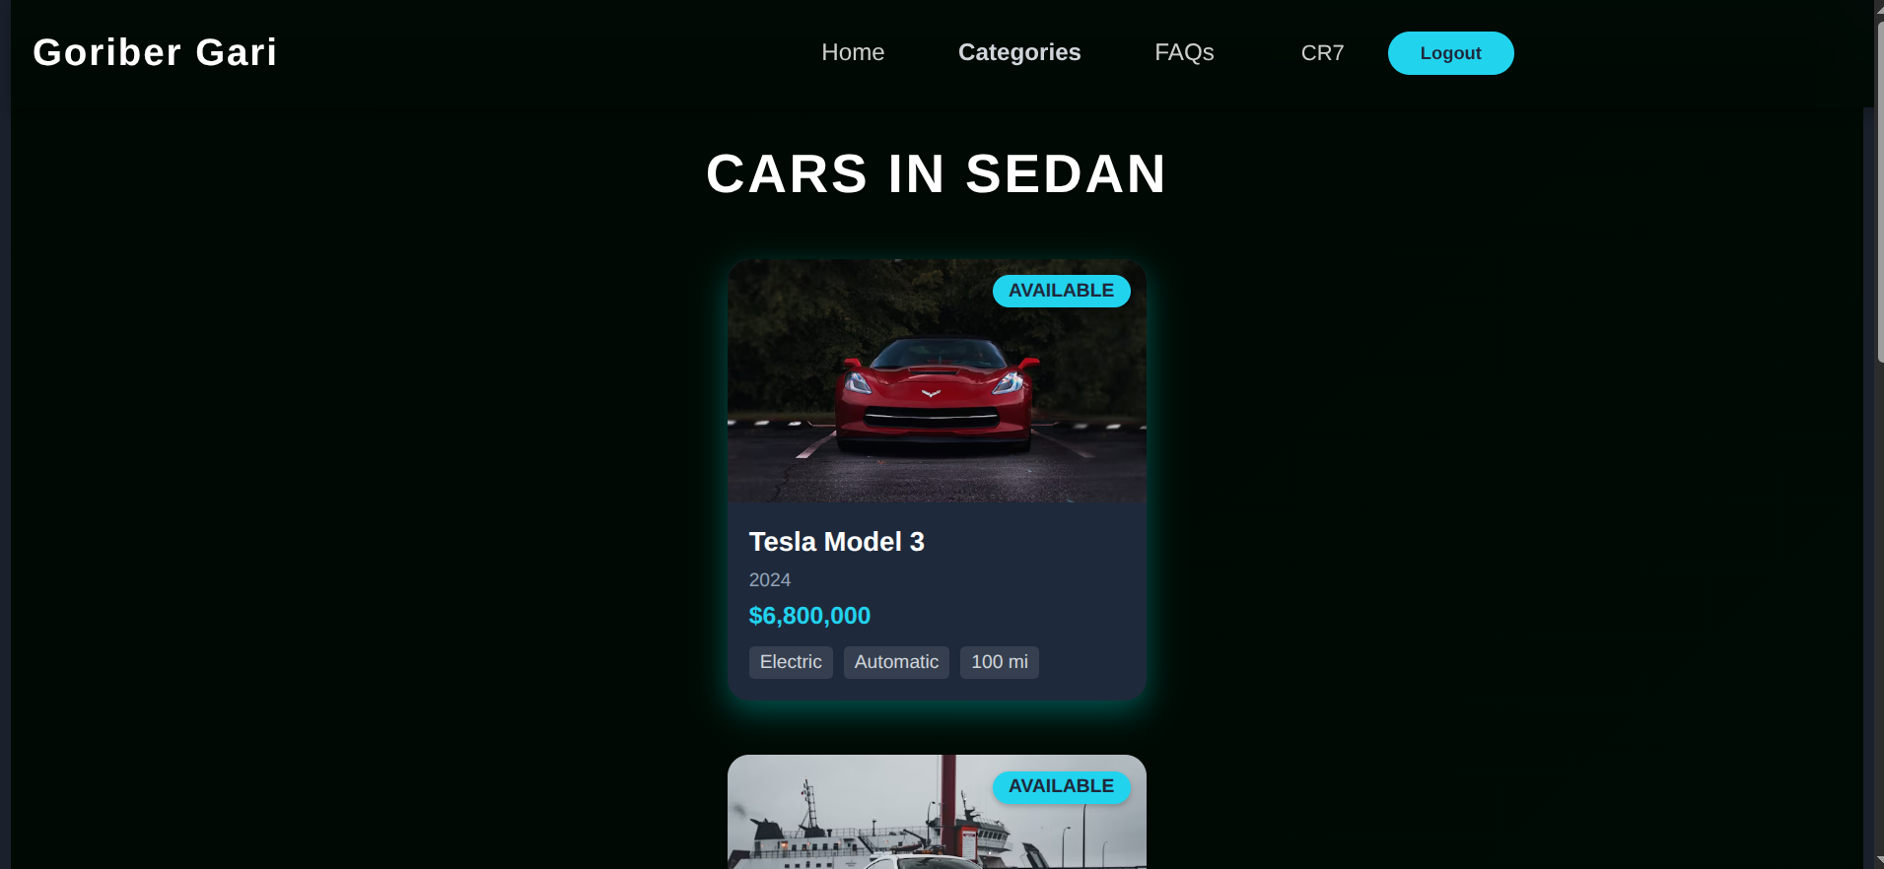
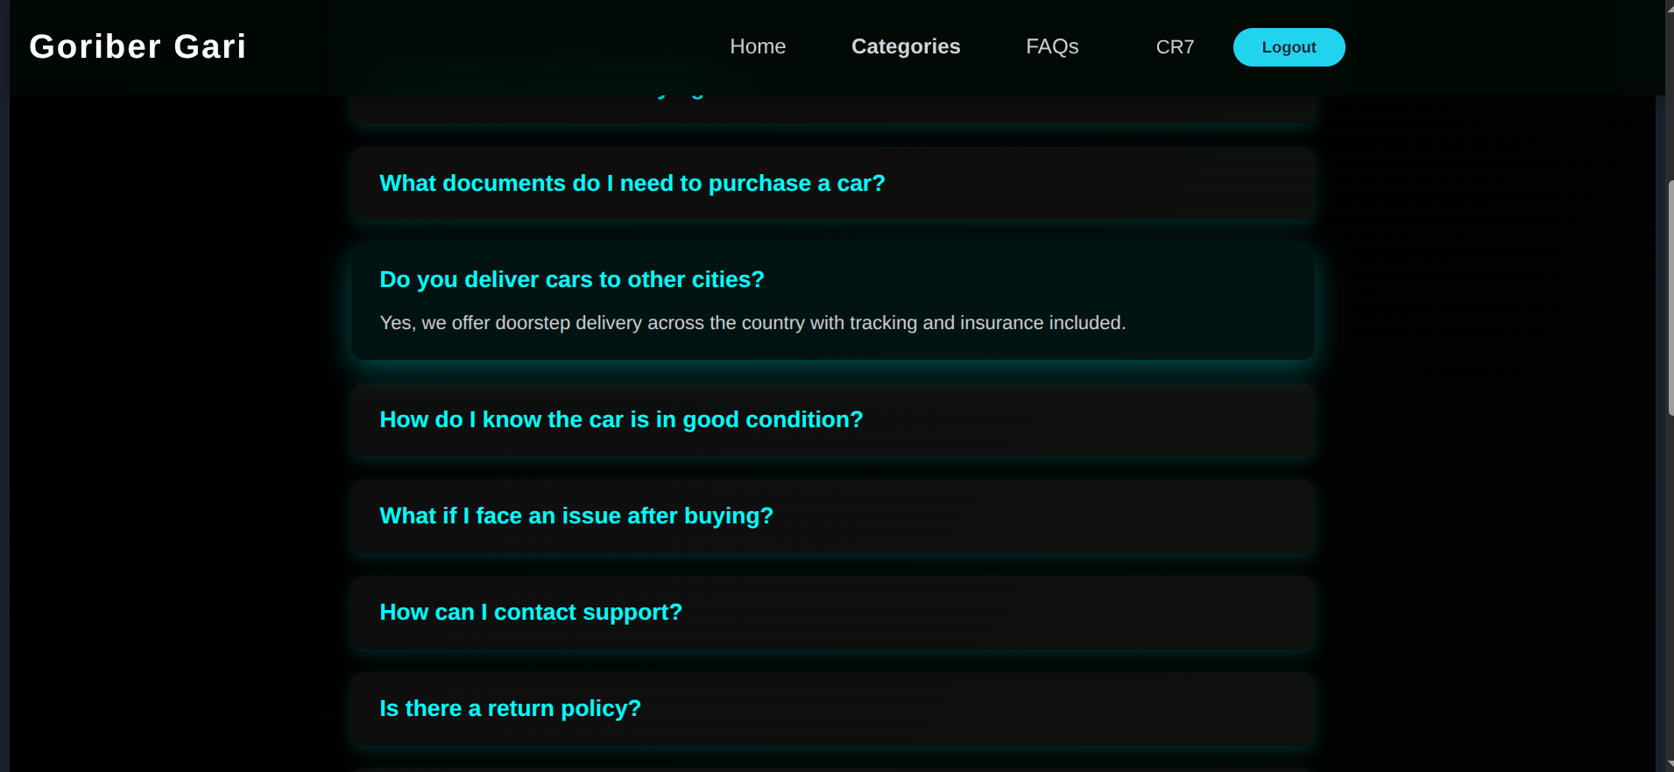

Slide 12
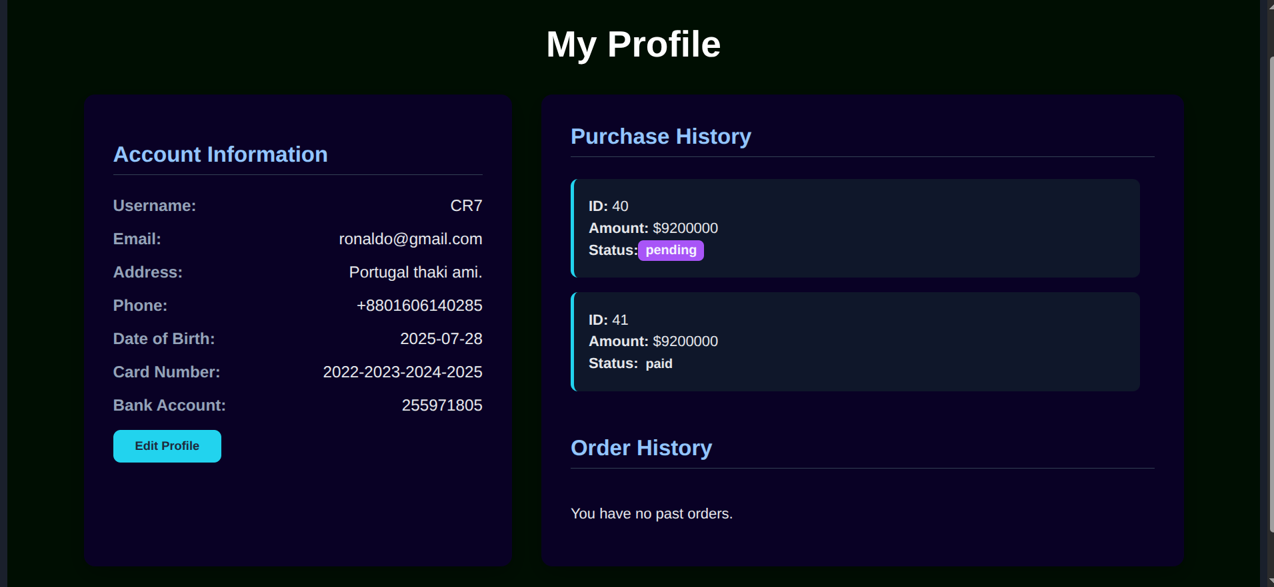
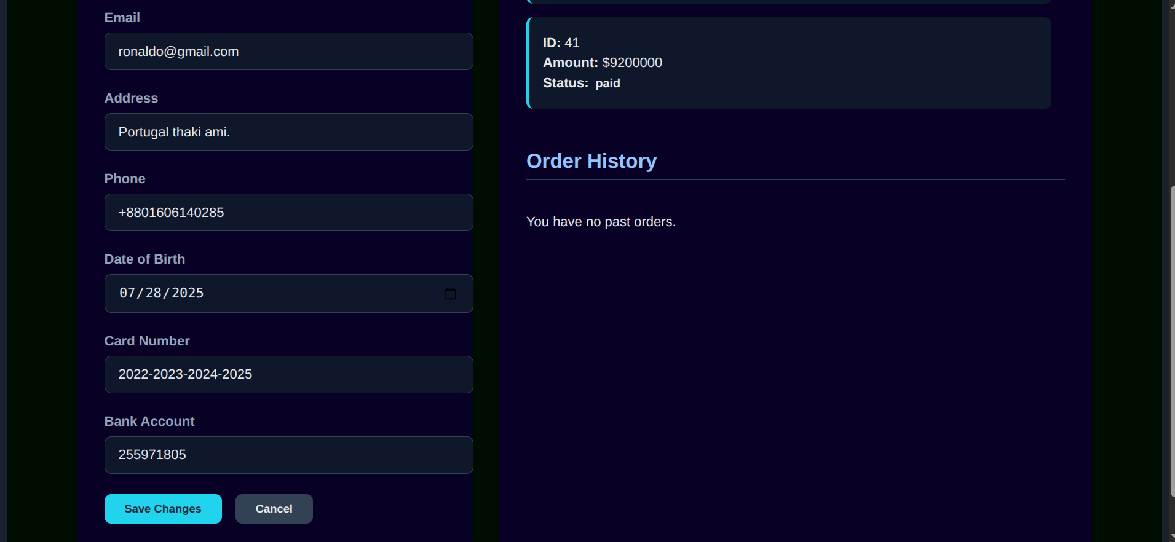
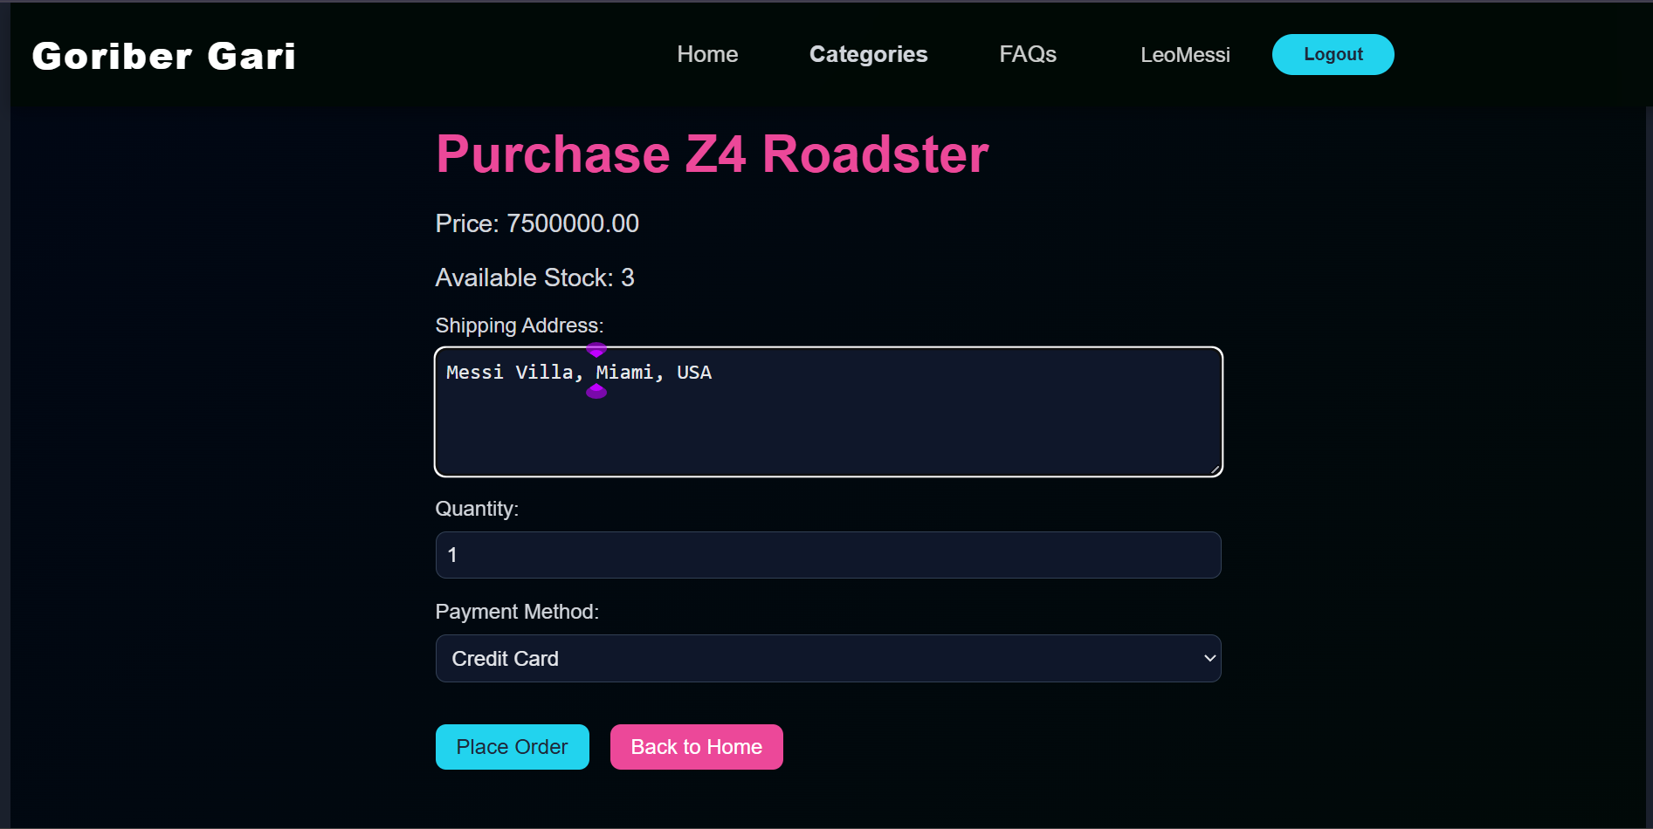
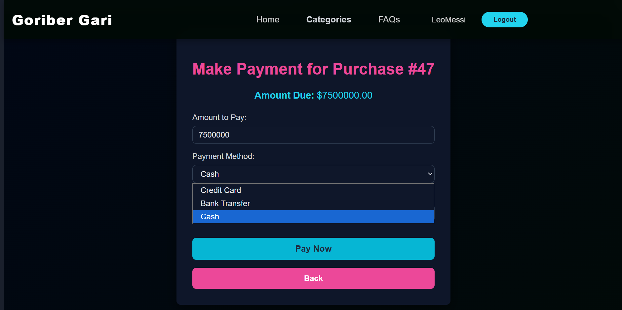

Slide 13
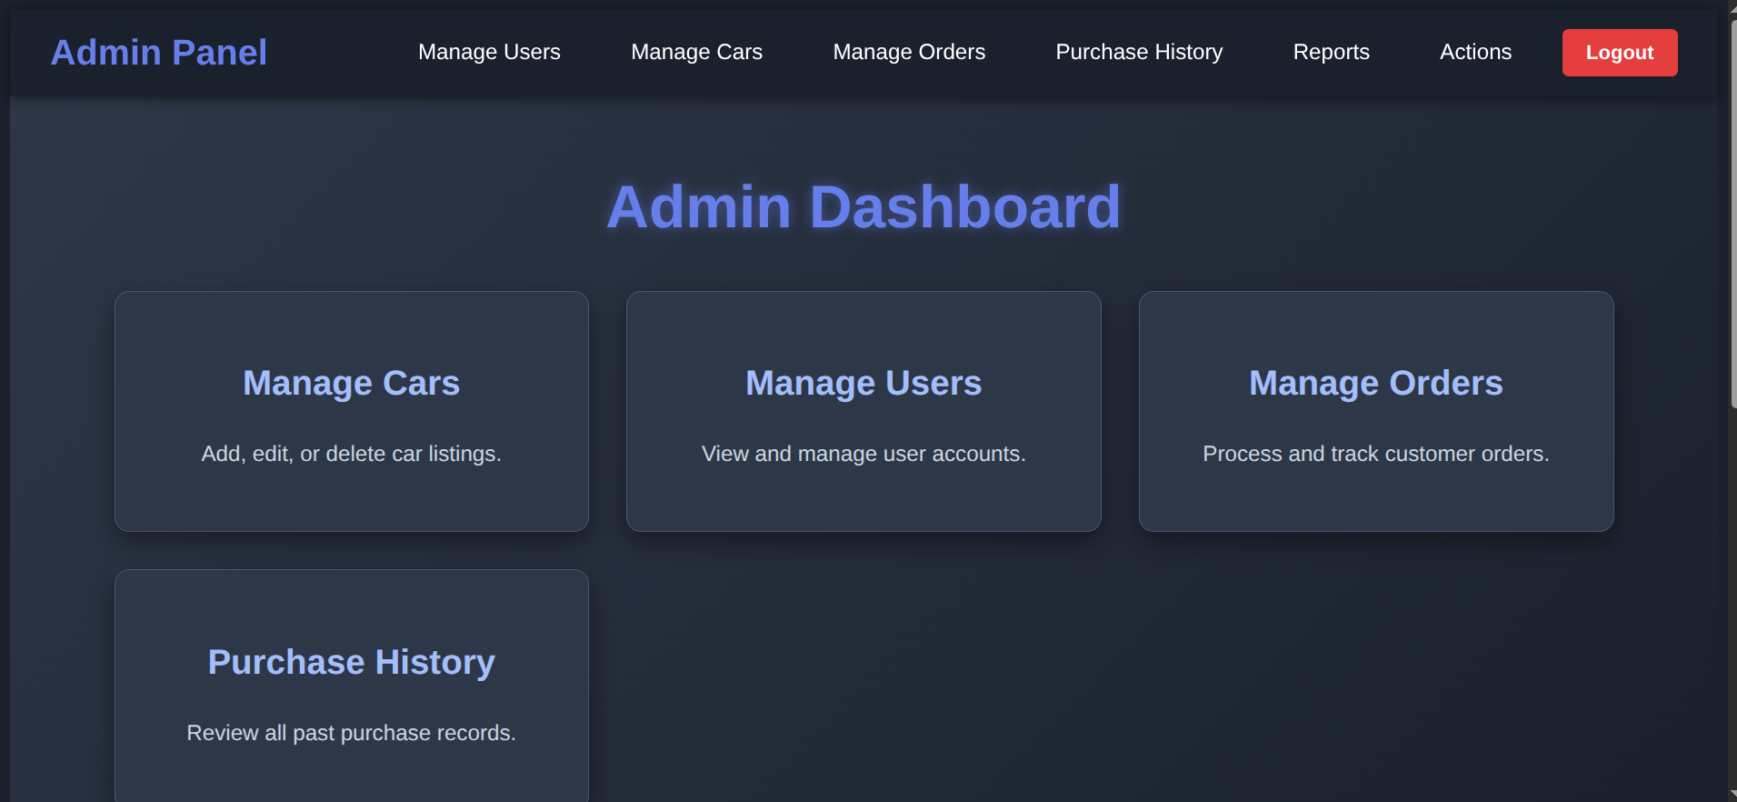
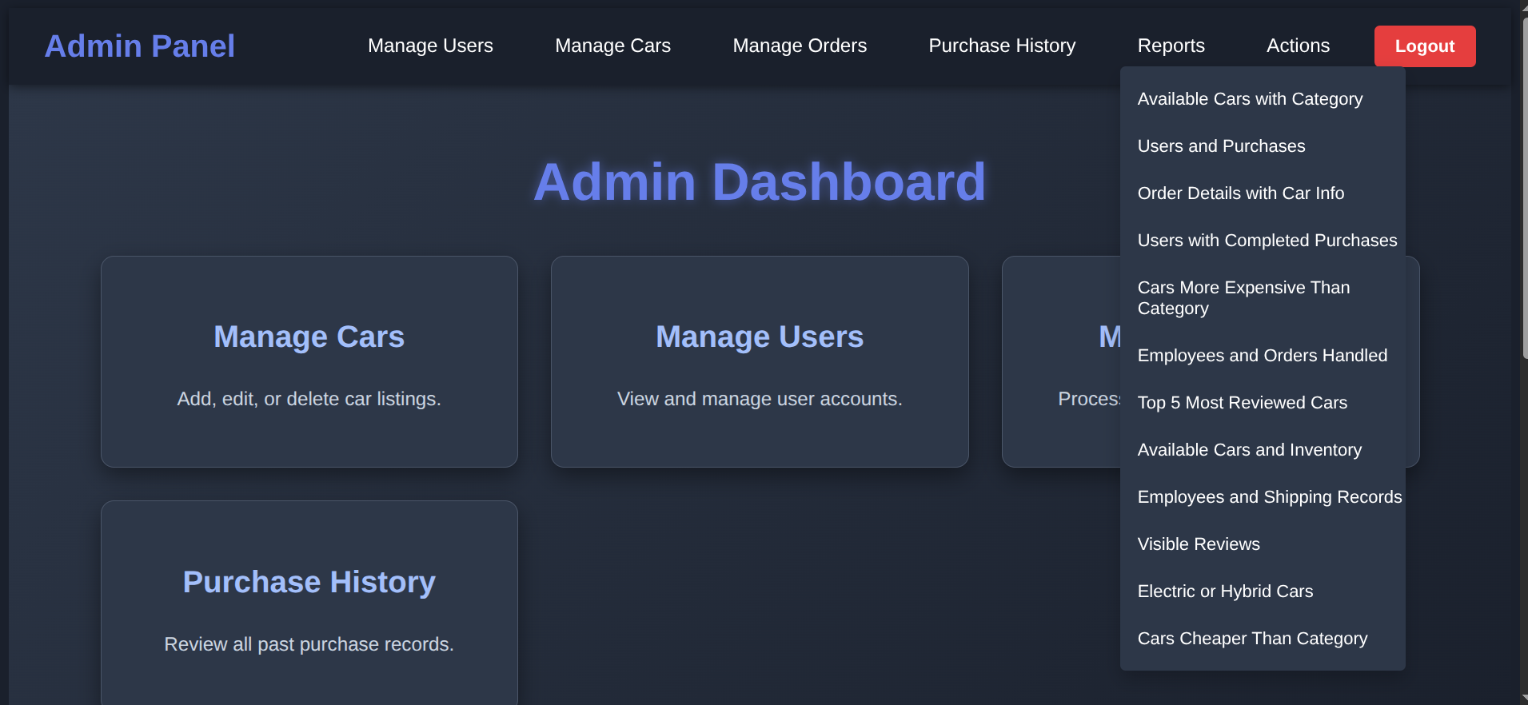
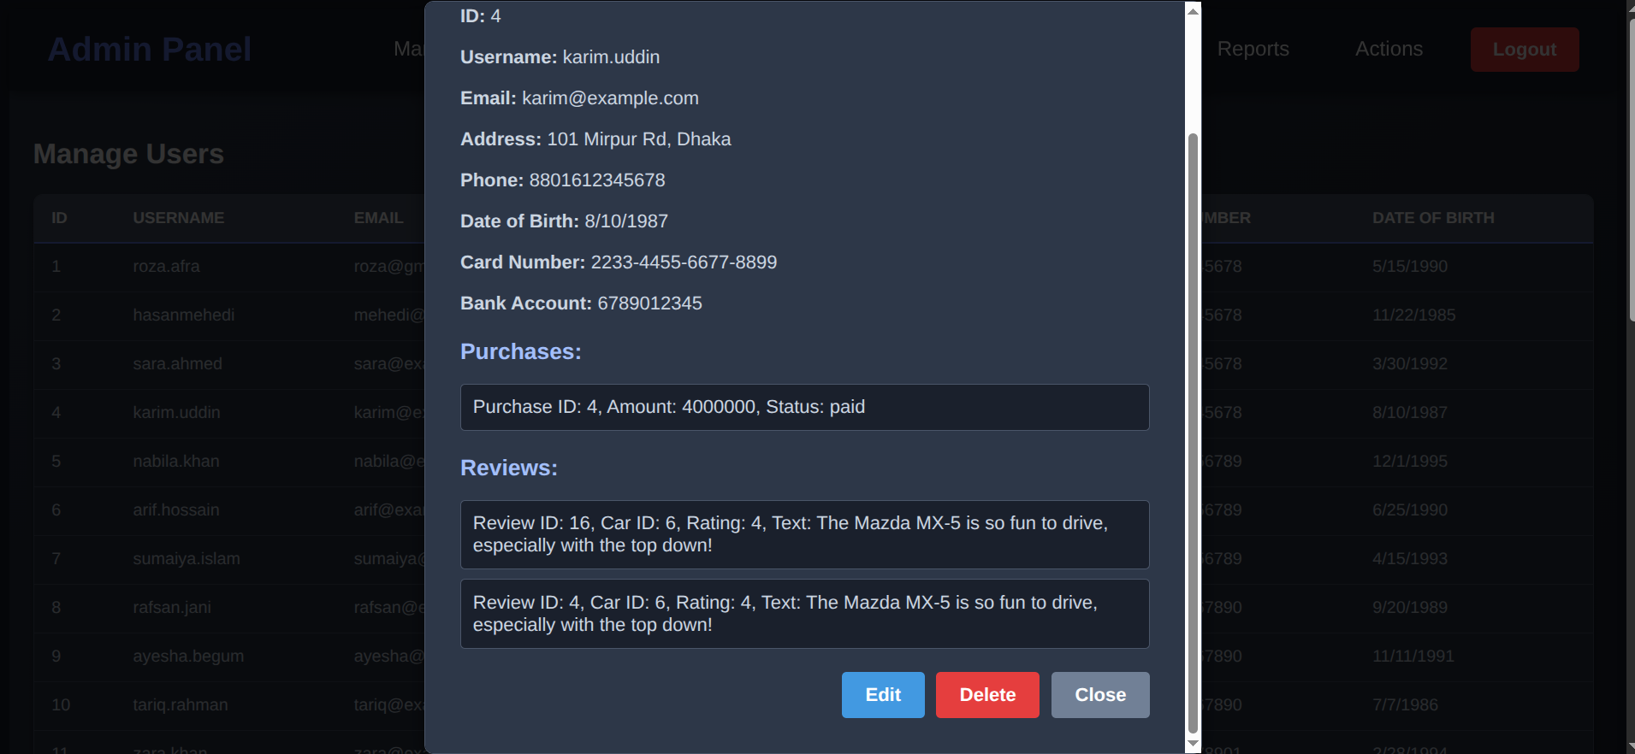
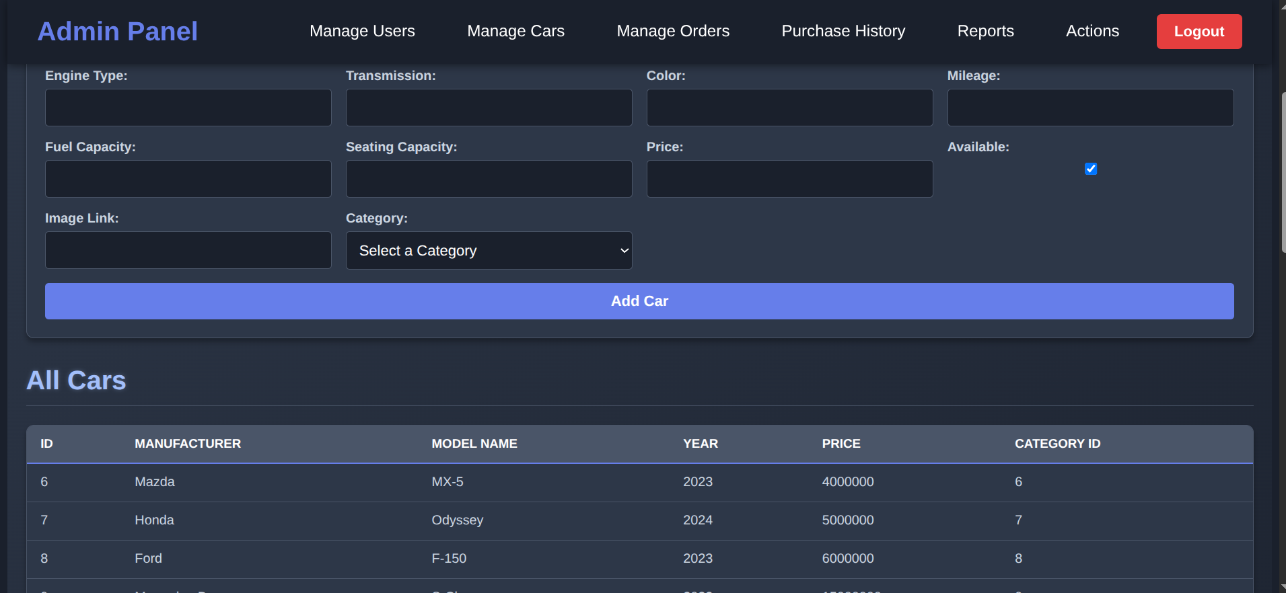

Slide 14
References
https://www.w3schools.com/REACT/DEFAULT.ASP
https://fastapi.tiangolo.com/tutorial/
https://www.geeksforgeeks.org/
https://www.postgresql.org/docs/current/tutorial.html

Slide 15
Thank You

